Slide 1
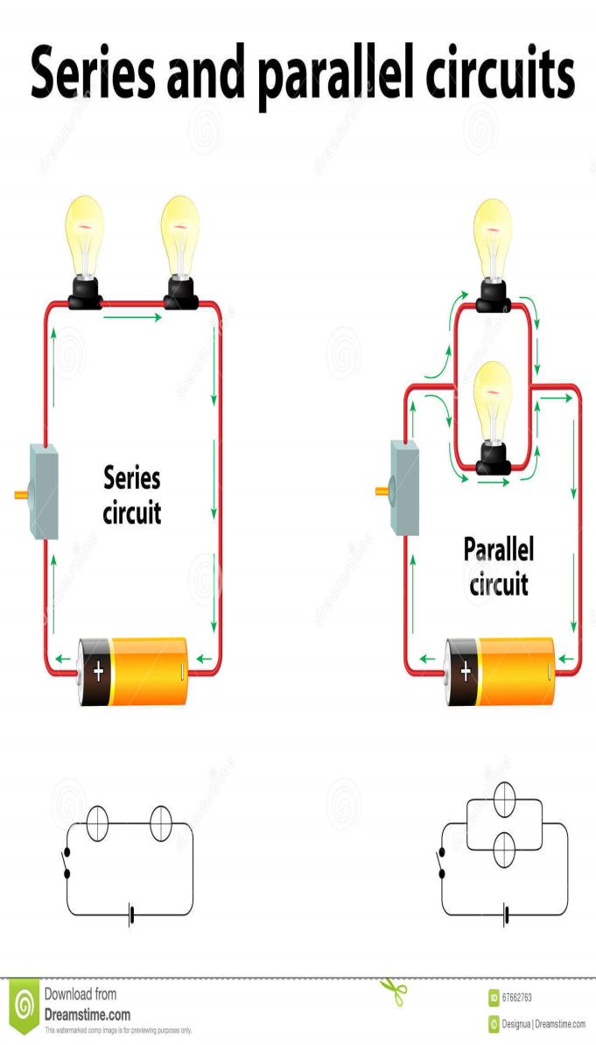
SERIES and PARALLEL (Page 36)
SERIES
PARALLEL
Bulbs. Resistors. Cells.
No choice: all electrons must pass through each.
Only one pathway.
If one pathway breaks, all current stops.
More bulbs in series: more total resistance with less current and dimmer light.
Bulbs. Resistors. Cells.
Electrons have a choice of which one to pass through.
More than one pathway.
If one path breaks, current can still go through others.
More bulbs in parallel: less total resistance, more current, same light strength.

Slide 2
QUESTIONS Pages 91-95
Question 1
(a) Only one path for current to flow in.
All items connected one after the other, with no different branches.
(b) More than one path for current to flow in.
Different items connected on different branches of circuit. [4]
2. Three cells in series and two bulbs in parallel. [4]
3. 2 cells in series, 2 bulbs in parallel, open switch controls only 1 bulb. [5]
Question 2
(a) decreases (b) decreases
(a) remains the same (b) increases [4]
Question 3
When current follows a path different from the circuit. [2]
Faulty wiring. Broken insulation. Circuit overload. Broken plugs. [3]
Gets hotter. [2]
Energy does not go through appliance. Hot wires. Damage. Fire. [4]

Slide 3
Question 4
Thinner wire is used. Burns out if overheated. Breaks pathway. Electrons stop flowing. [4]
Prevents damage to the appliance, and stops fire from breaking out. [2]
Cheap, and can be bought easily. [2]
You need to replace the old one with a new one. [2]
A switch that trips if electric current gets too big. [2]
Act quicker. More reliable. Easy to switch back on. [6]
Question 5
Converts electrical energy into other useful forms of energy. [2]
(a) To light energy (b) To sound energy (c) To movement
(d) To sound energy (e) To heat energy. [5]
Question 6
Iron. Toaster. Kettle. Stove. Heater. [3]
Breaking down compounds into their elements, using electricity. [2]
(a) Positive Anode (b) Chlorine gas (c) Negative Cathode
(d) Copper metal. [4]

Slide 4
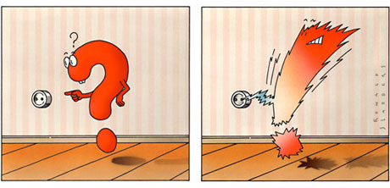
Question 7
Putting a layer of metal around another substance. [2]
Bath taps. Towel rails. Car parts. Cutlery. [3]
To look good. To protect the metal beneath it. [2]
It does not rust/corrode. Can be easily polished. Tough metal. [3]
Question 8
Magnetic [1]
Iron [1]
Magnet [1] 4. ElectroMagnet [1]
5. Put bigger current through it. Put more turns in the coil. [2]
6. Doctors use them to take metals out of eyes. Telephones. Speakers. Computers. Doorbells. Cranes in junkyards. [3]

